Slide 1
Deep Learning: An Overview
Dr. Hsinchun Chen, University of Arizona
Updated April, 2020
Acknowledgements: Lex Fridman, MIT; Y. LeCun, Y. Bengio, and G. Hinton, “Deep Learning,” Nature, May 28, 2015.

Slide 2
Outline
Deep Learning: Introduction
Motivation
Deep Learning Intuition
Major DL Architectures and Algorithms
Supervised earning
Unsupervised Learning
Reinforcement Learning

Slide 3
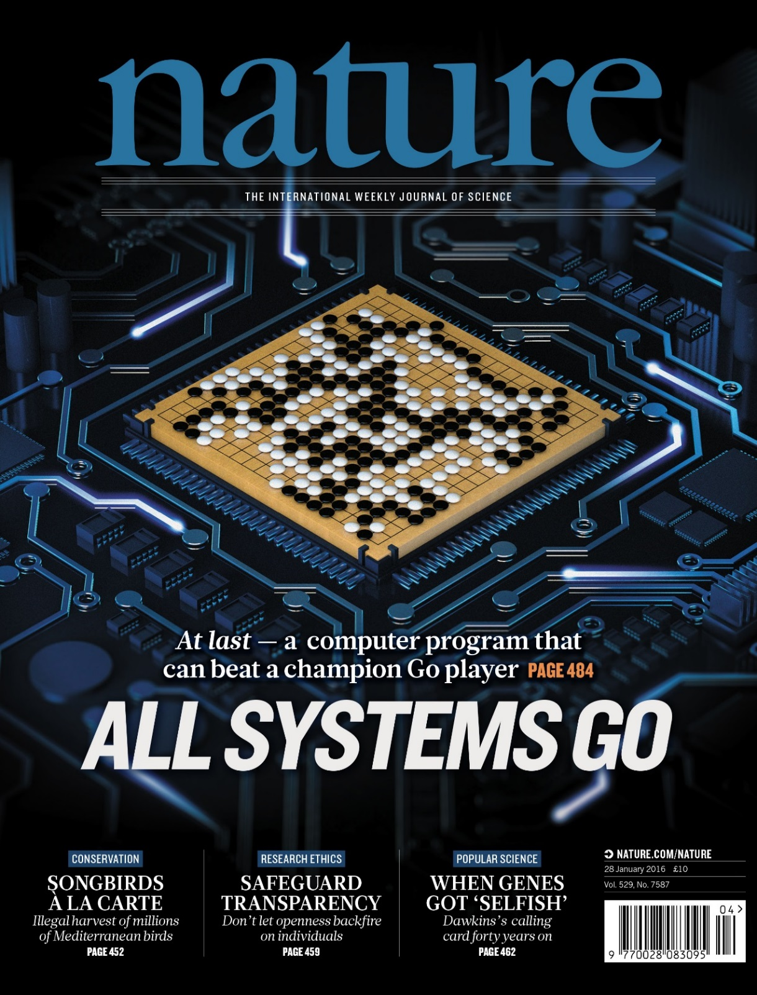
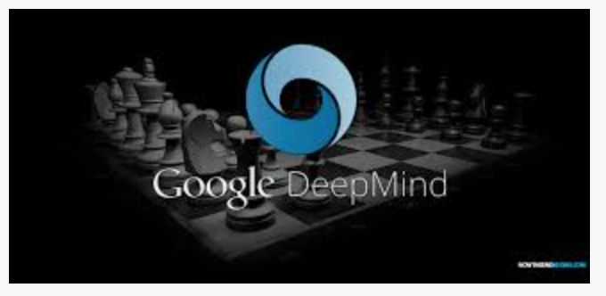
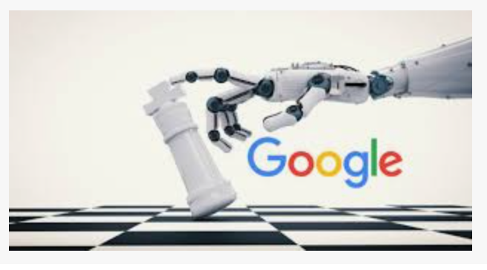
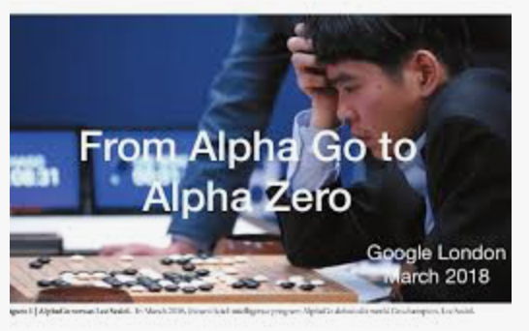
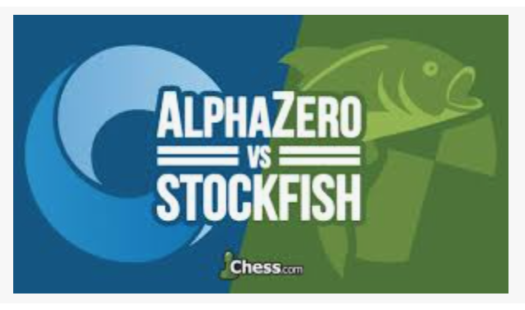
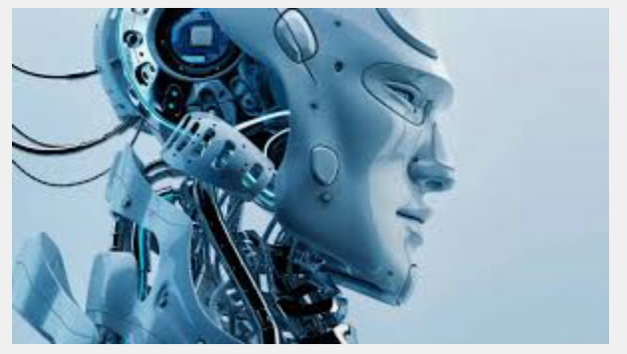
AI & Deep Learning: The Revolution
Nature, 27 January 2016:
“…AlphaGo program applied deep learning in neural networks (convolutional NN) — brain-inspired programs in which connections between layers of simulated neurons are strengthened through examples and experience.”

Slide 4
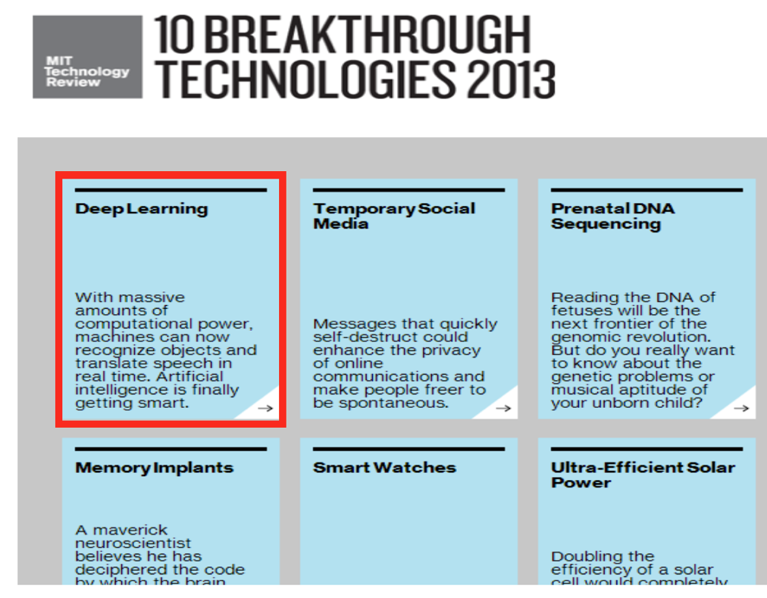

Slide 5
Deep Learning Today
Advancement in Speech Recognition
Microsoft and Google have both deployed DL-based speech recognition systems in their products
Advancement in Computer Vision
The record holders on ImageNet and Semantic Segmentation are convolutional nets
Advancement in Natural Language Processing
Google Translate included and deployed DL-based machine translation for many languages.
Many other applications from autonomous vehicles to robotics…

Slide 6
Motivations for Deep Architectures
Insufficient depth can hurt
With shallow architecture (SVM, NB, KNN, etc.), the required number of nodes in the graph (i.e. computations, and also number of parameters, when we try to learn the function) may grow very large.
Many functions that can be represented efficiently with a deep architecture cannot be represented efficiently with a shallow one.
The brain has a deep architecture
The visual cortex shows a sequence of areas each of which contains a representation of the input, and signals flow from one to the next.
Cognitive processes seem deep
Humans organize their ideas and concepts hierarchically.
Humans first learn simpler concepts and then compose them to represent more abstract ones.
Notes:
Simplify it.

Slide 7
Representation Learning & Deep Learning
Representation Learning is a set of methods that allows a machine to be fed with raw data and to automatically discover the representations needed for detection or classification.
Deep Learning methods are representation learning methods with multiple levels of representation, obtained by composing simple but non-linear modules that each transform the representation at one level (starting with the raw input) into a representation at a higher, slightly more abstract level. With the composition of enough such transformations, very complex functions can be learned.
E.g., in image recognition, pixels ➔ edges ➔ motifs ➔ parts ➔ objects; in speech recognition, sounds ➔ phones ➔ phonemes ➔ syllables ➔ words ➔ phrases ➔ sentences
Many DL methods build upon Deep Neural Networks (e.g., CNN).

Slide 8
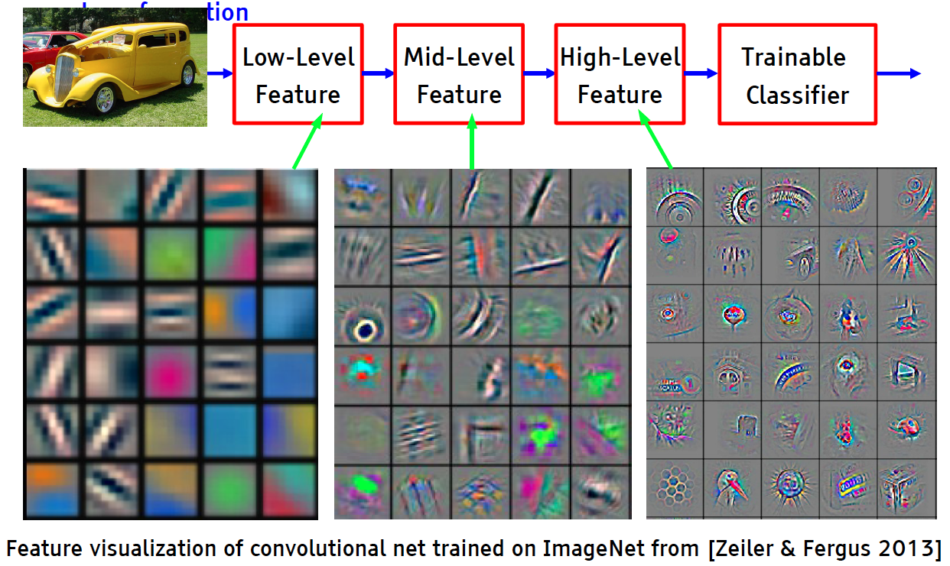
Deep Learning = Learning Hierarchical Representations

Slide 9
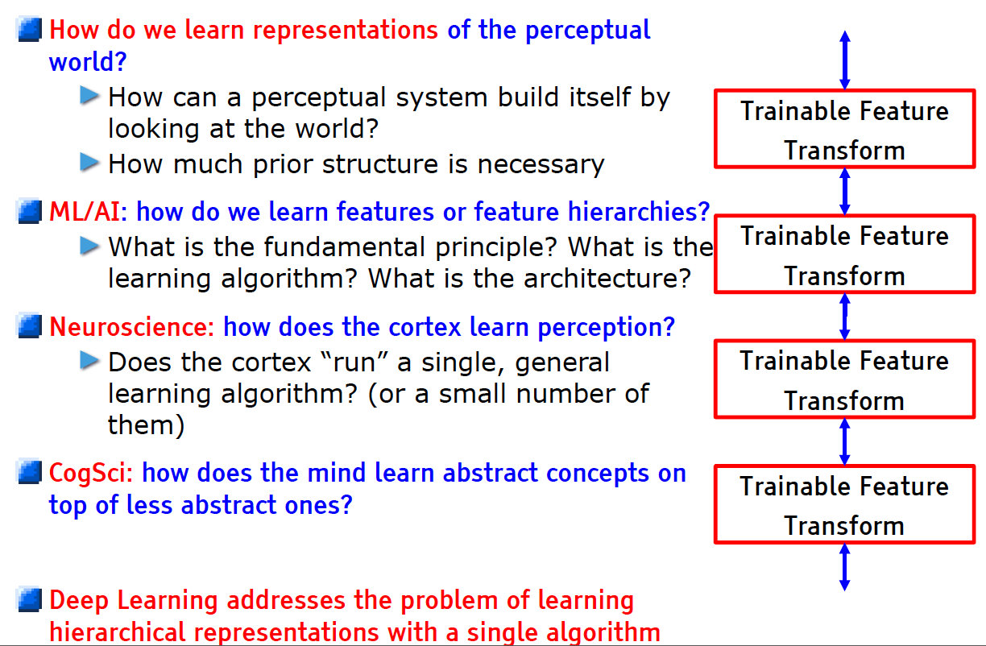
Learning Representations: a challenge for ML, CV, AI, Neuroscience, Cognitive Science...

Slide 10
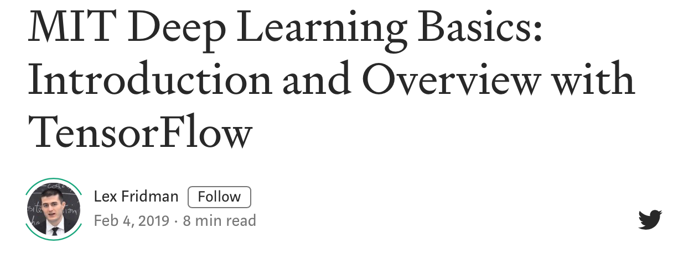
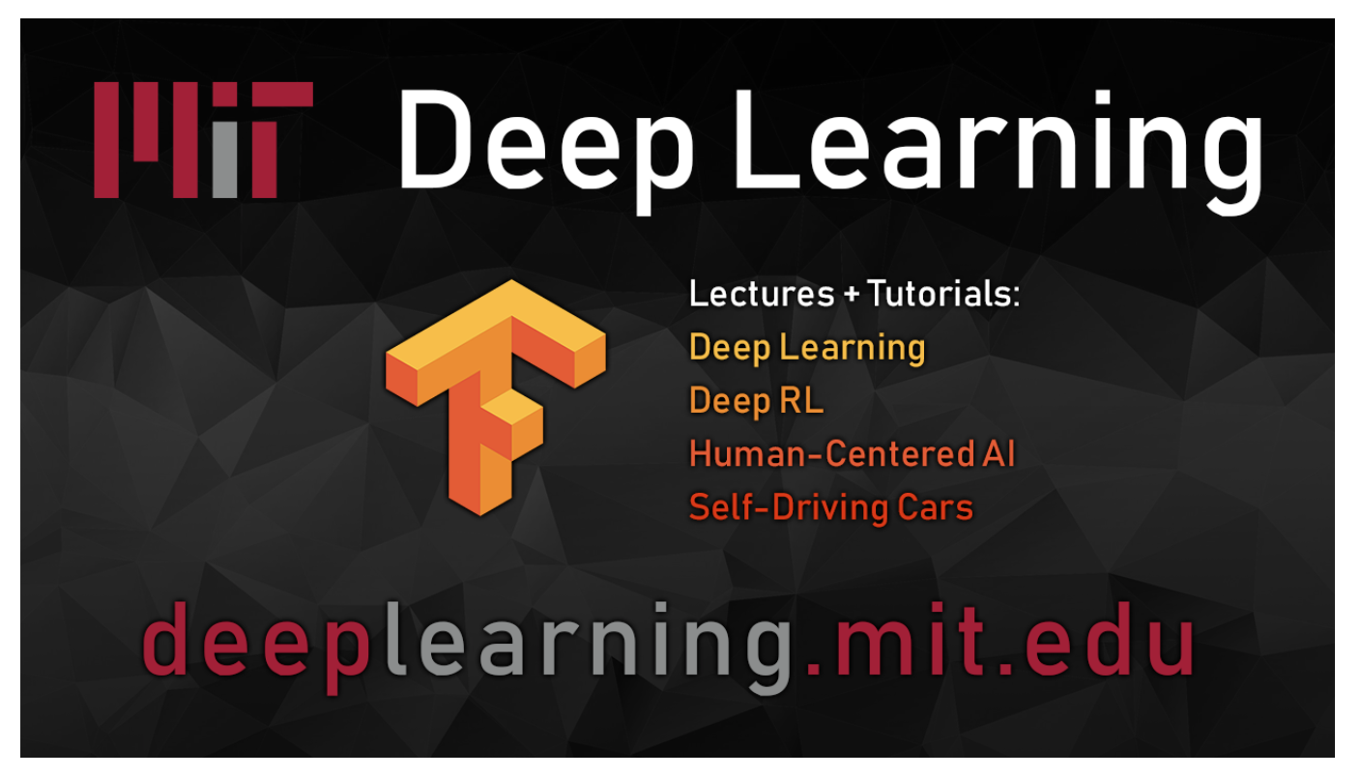
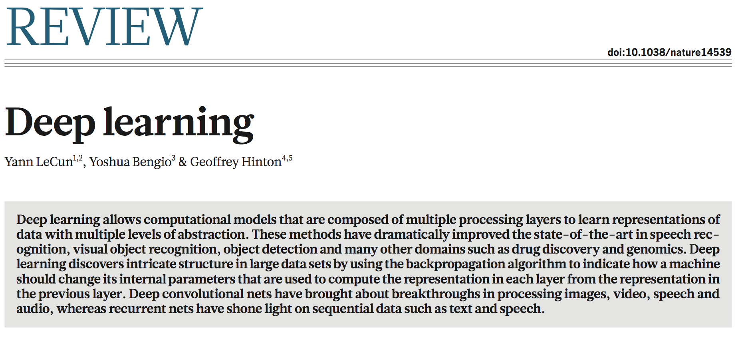
Major DL Architectures & Paradigms
February, 2019

Slide 11
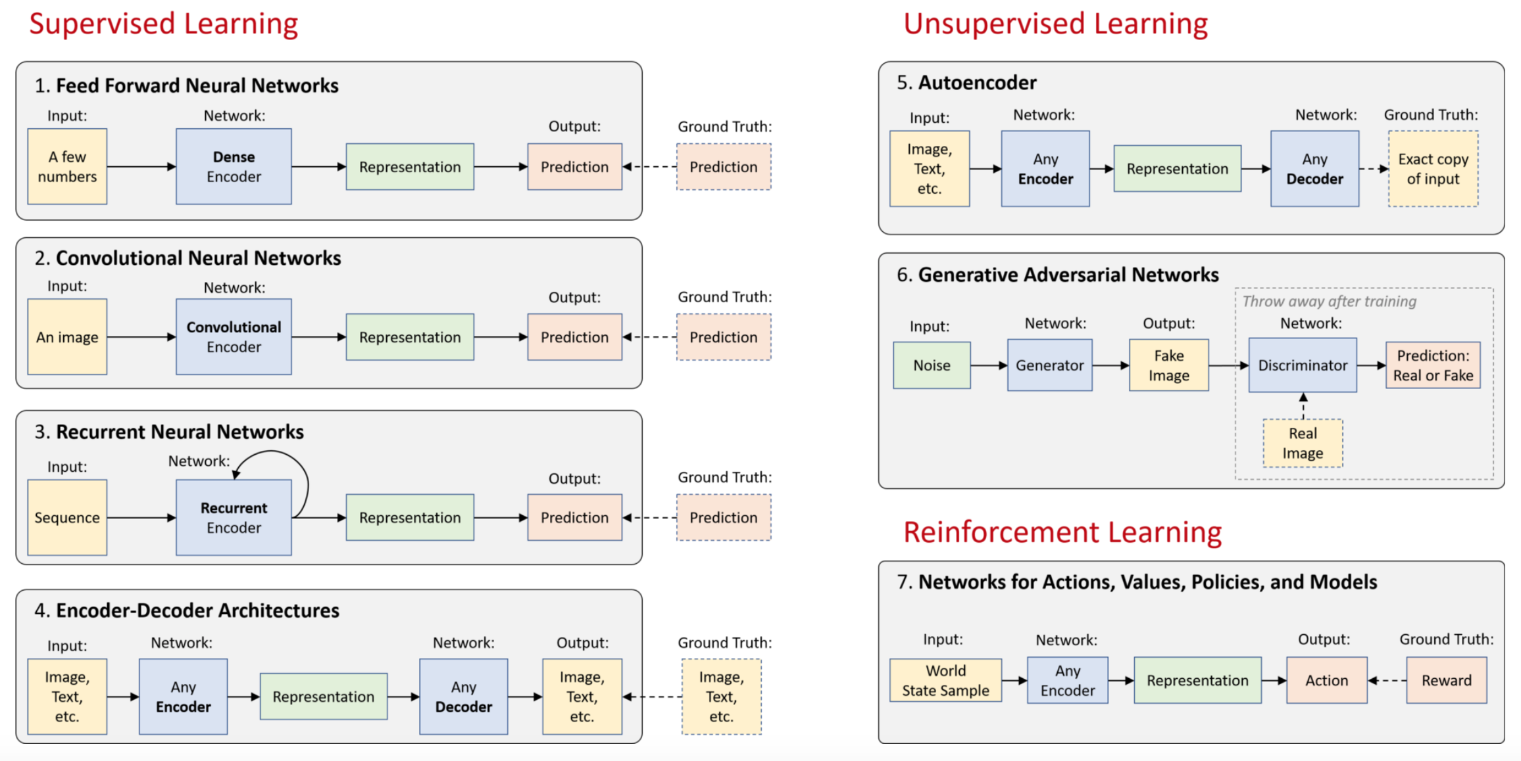
Major DL Architectures & Paradigms (Fridman, 2019)

Slide 12
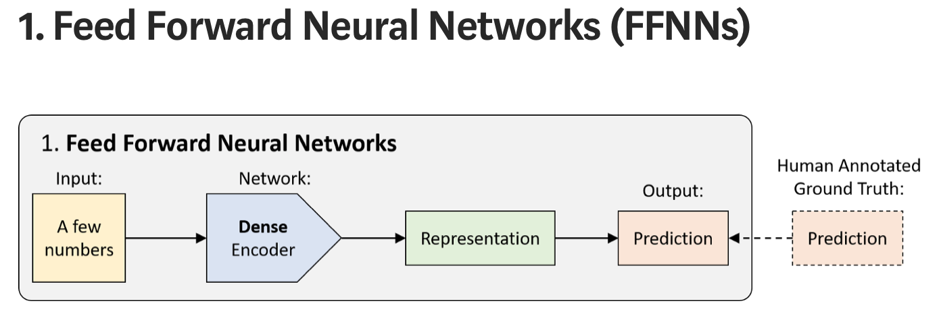
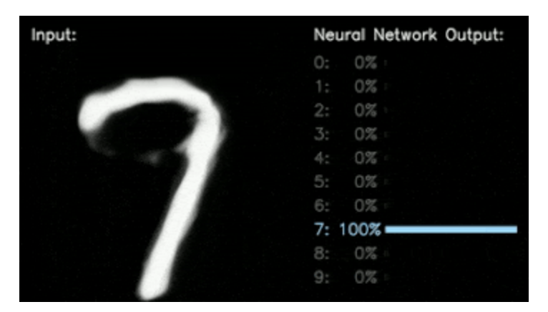
Technically, most networks in deep learning can be considered FFNNs, but usually “FFNN” refers to its simplest variant: a densely-connected multilayer perceptron (MLP).
Dense encoders are used to map an already compact set of numbers on the input to a prediction: either a classification (discrete) or a regression (continuous).
Classifying handwritten digits

Slide 13
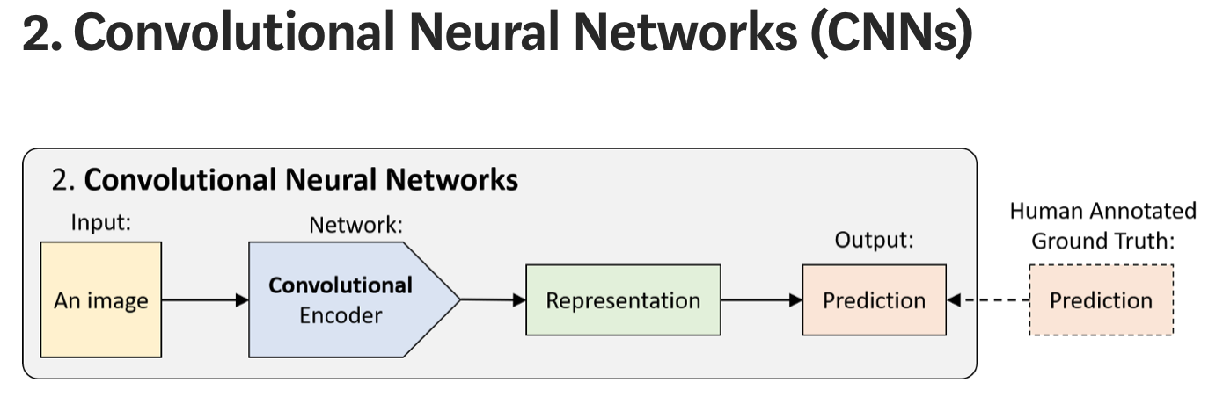
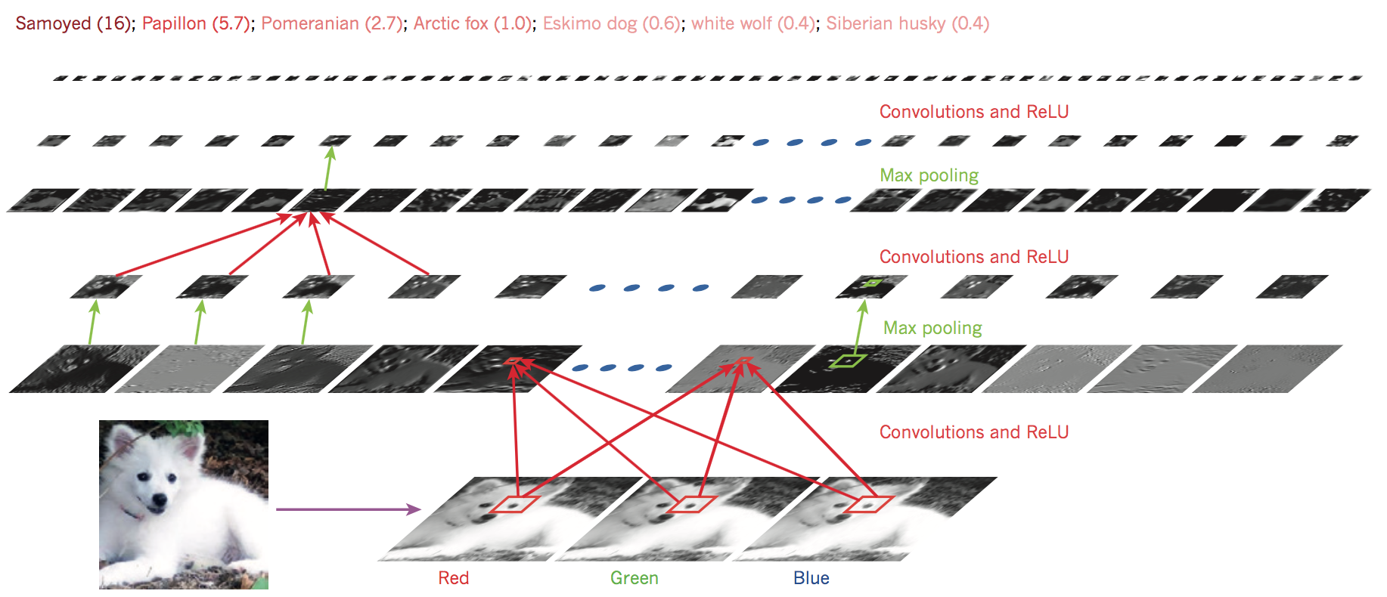
CNNs (aka ConvNets) are FFNN that use a spatial-invariance trick to efficiently learn local patterns, most commonly, in images. Instead of using only densely-connected layers, they use convolutional layers (convolutional encoder), with local connectivity and shared weights.
CNNs are used for image classification, object detection, video action recognition, and any data that has some spatial invariance in its structure (e.g., speech, audio).
Classifying images

Slide 14
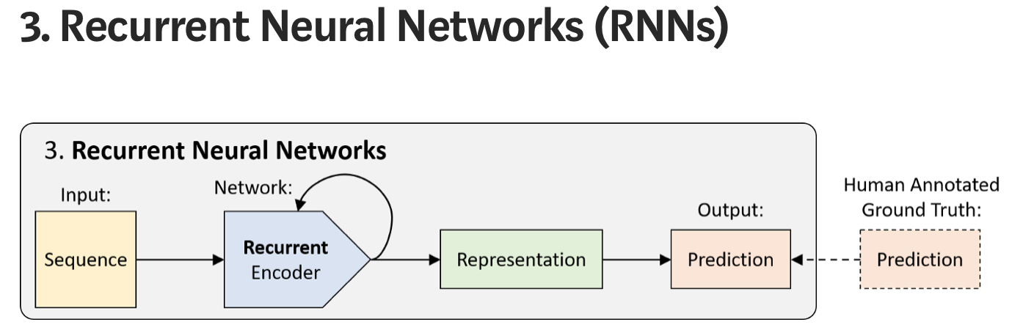


Classifying sentiment
1/0, Good/Bad?
RNNs are NNs that have cycles and therefore have “state memory”. They can be unrolled in time to become FFNN where the weights are shared.
Just as CNNs share weights across “space”, RNNs share weights across “time”. This allows them to process and efficiently represent patterns in sequential data.
Many variants of RNNs modules have been developed, including LSTM and GRU to help learn patterns in longer sequences. Applications include natural language modeling, speech recognition, sentiment analysis, etc.
100 dims
Fully connected layer
Recurrent cell
Word embeddings
32 dims
Review
… movie fantastic, awesome …

Slide 15
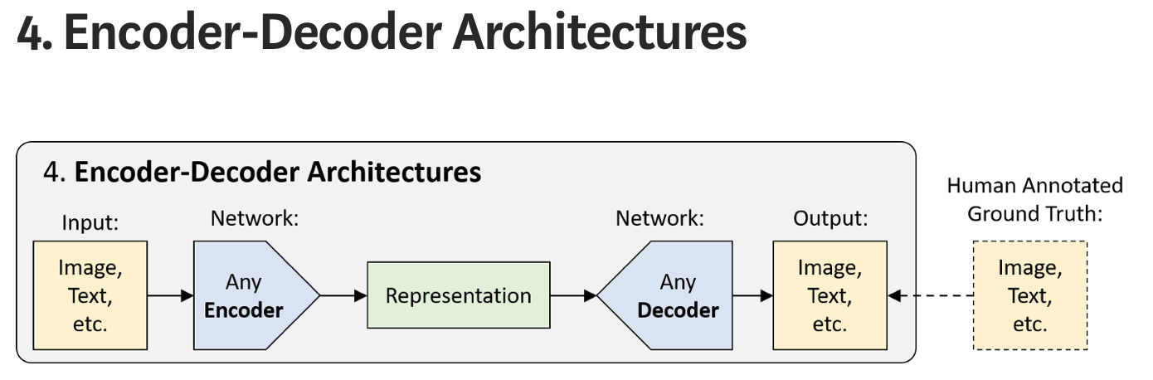
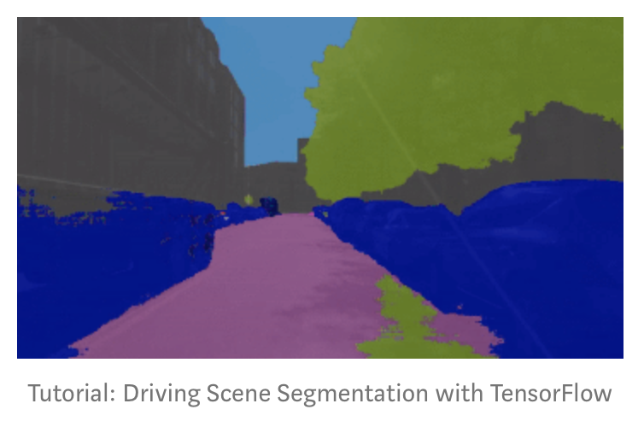
“Encoder-Decoder” architecture is a higher level concept that builds on the encoding step to, instead of making a prediction, generate a high-dimensional output via a decoding step by up-sampling the compressed representation.
Applications include semantic segmentation, machine translation, scene segmentation, etc.
Autonomous vehicle visual perception

Slide 16
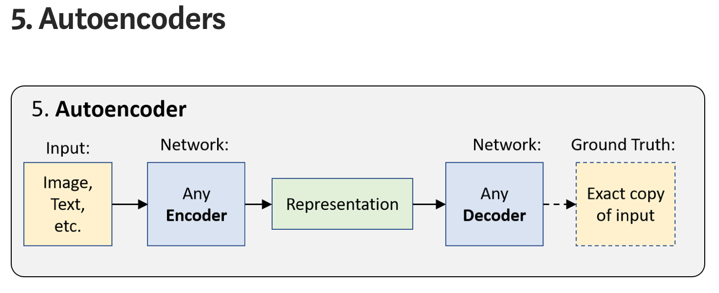
Autoencoders are one of the simpler forms of “unsupervised learning” taking the encoder-decoder architecture and learning to generate an exact copy of the input data.
Since the encoded representation is much smaller than the input data, the network is forced to learn how to form the most meaningful representation.
Applications include unsupervised embeddings, image denoising, etc.

Slide 17
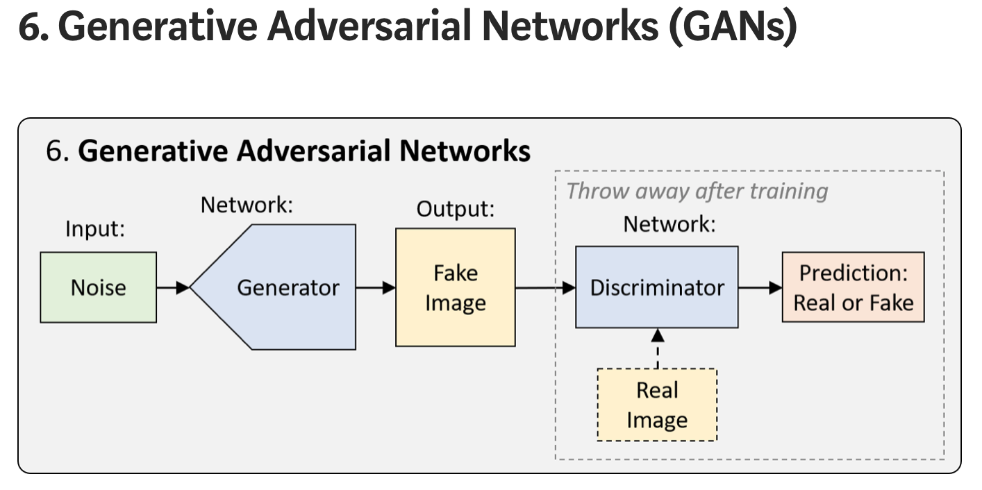
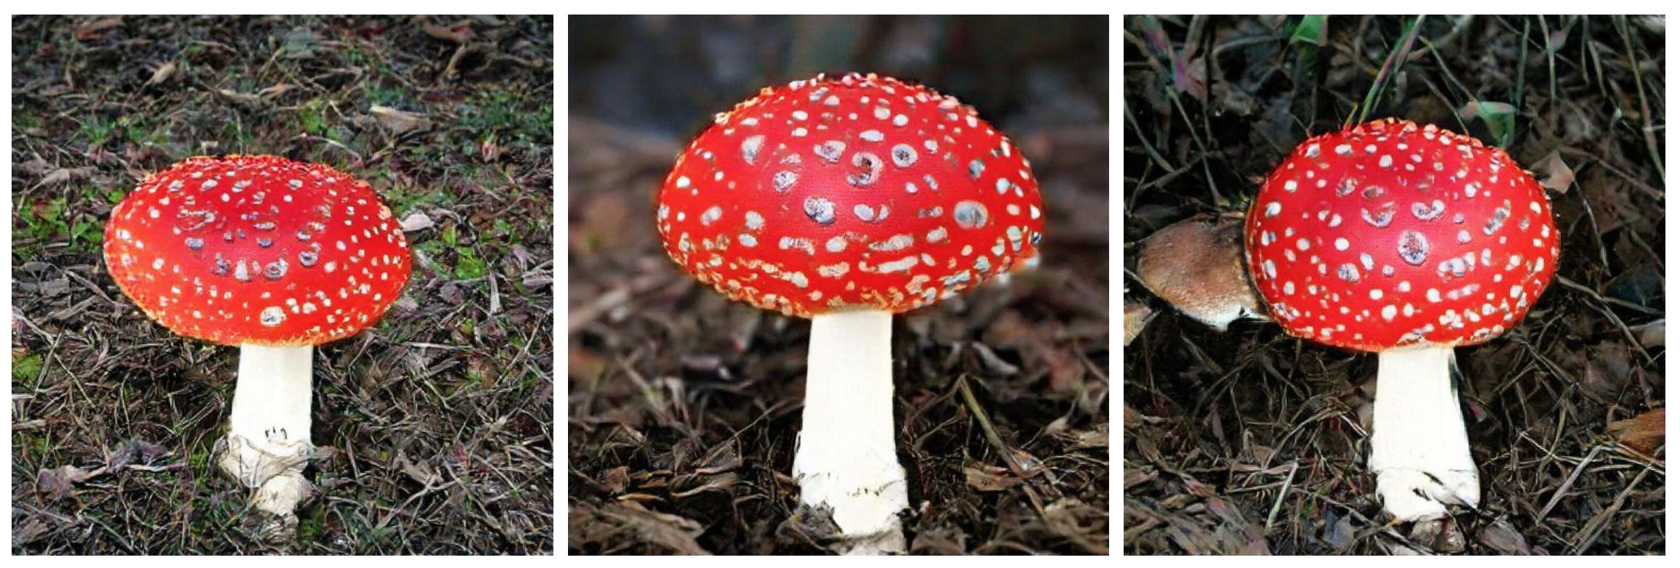
GANs are a framework for training networks optimized for generating new realistic samples from a particular representation.
In its simplest form, the training process involves two networks. One network, called the generator, generates new data instances, trying to fool the other network, the discriminator, that classifies images as real or fake.
Applications include fake images, fake videos, political dis-information.
Images generated by BigGAN

Slide 18
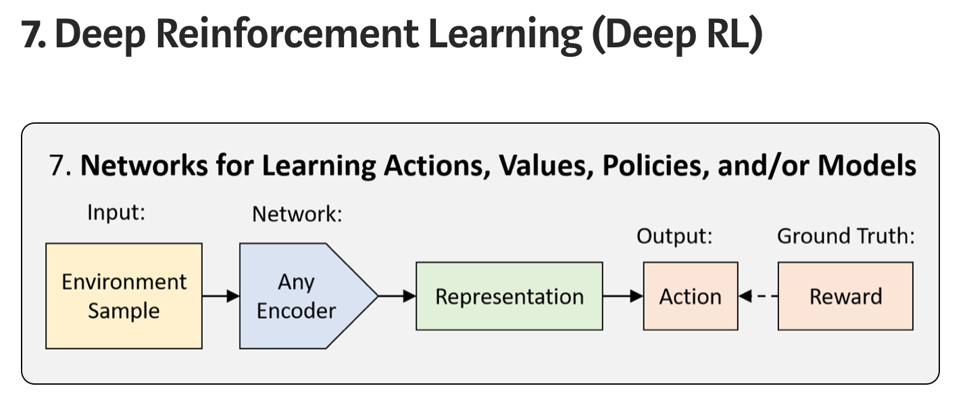
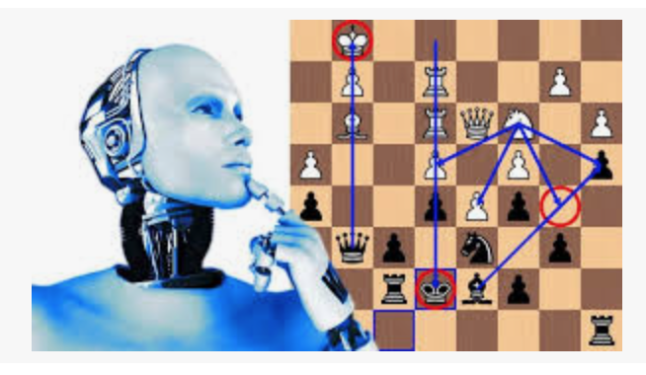
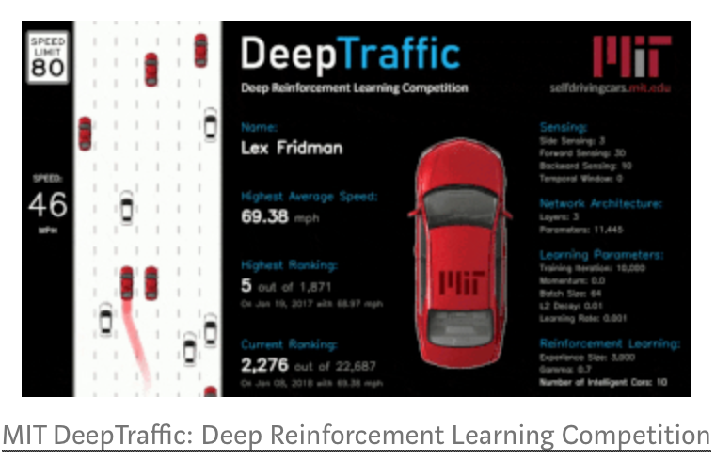
Reinforcement learning (RL) is a framework for teaching an agent how to act in the world in a way that maximizes reward. When the learning is done by a neural network, we refer to it as Deep Reinforcement Learning (Deep RL).
Deep RL allows us to apply neural networks in simulated or real-world environments when sequences of decisions need to be made. Applications include game playing, robotics , malware detection, autonomous vehicle, and much more.

